Slide 1
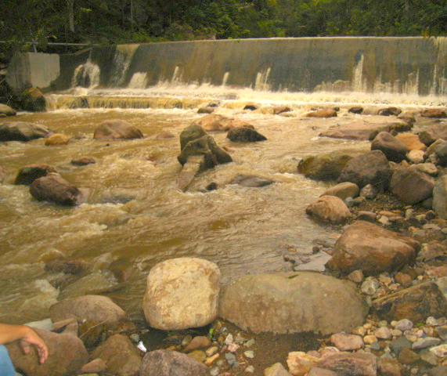
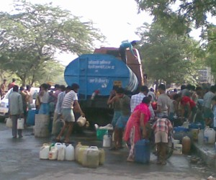
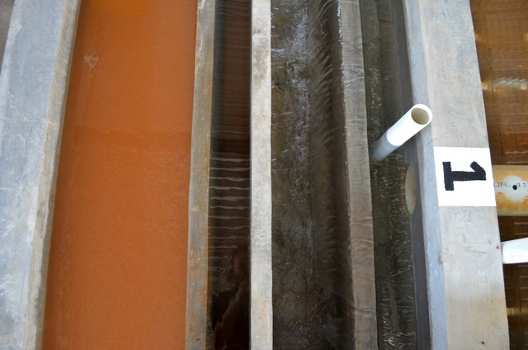
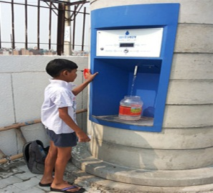
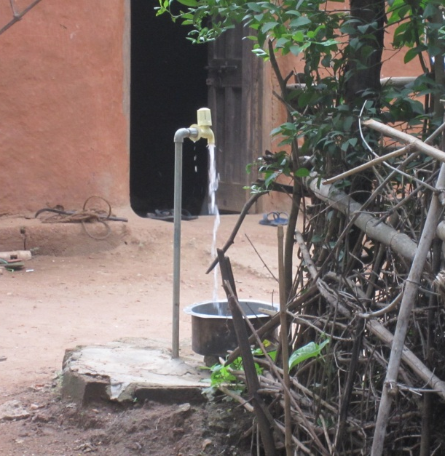
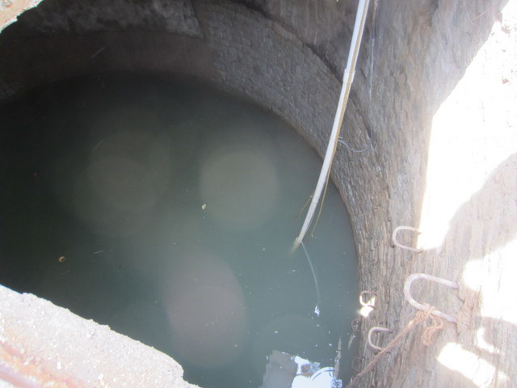
Drinking Water Contaminants

Slide 2
Class announcements
Python Tutorial 1 due on Tuesday night
Read entire tutorial up to and including problem 10 before starting to code
PLAY: Write some simple code (perhaps rewrite the PV=nRT problem – solve for a different variable)
Why did we create functions (aide_design)?
Head loss (major and minor)
This is not a Python Class – functions, units, graphs, print
Notes:
Use tools!

Slide 3
Water Quality
History of our understanding of waterborne disease
Brief history of water treatment
Drinking Water Standards: how do we decide what is allowed in the water we drink?

Slide 4
The flush toilet contaminates safe drinking water with feces
Toilets made cities habitable by carrying human waste “away”
Unfortunately “away” was too close…
In the early 1800s new flush toilets and sewers carried the waste directly into rivers and streams
Chicago!
London drained its raw sewage into and withdrew its drinking water from the Thames River, both without any treatment.
Several of the drinking water intakes were below sewage outfalls!

Slide 5
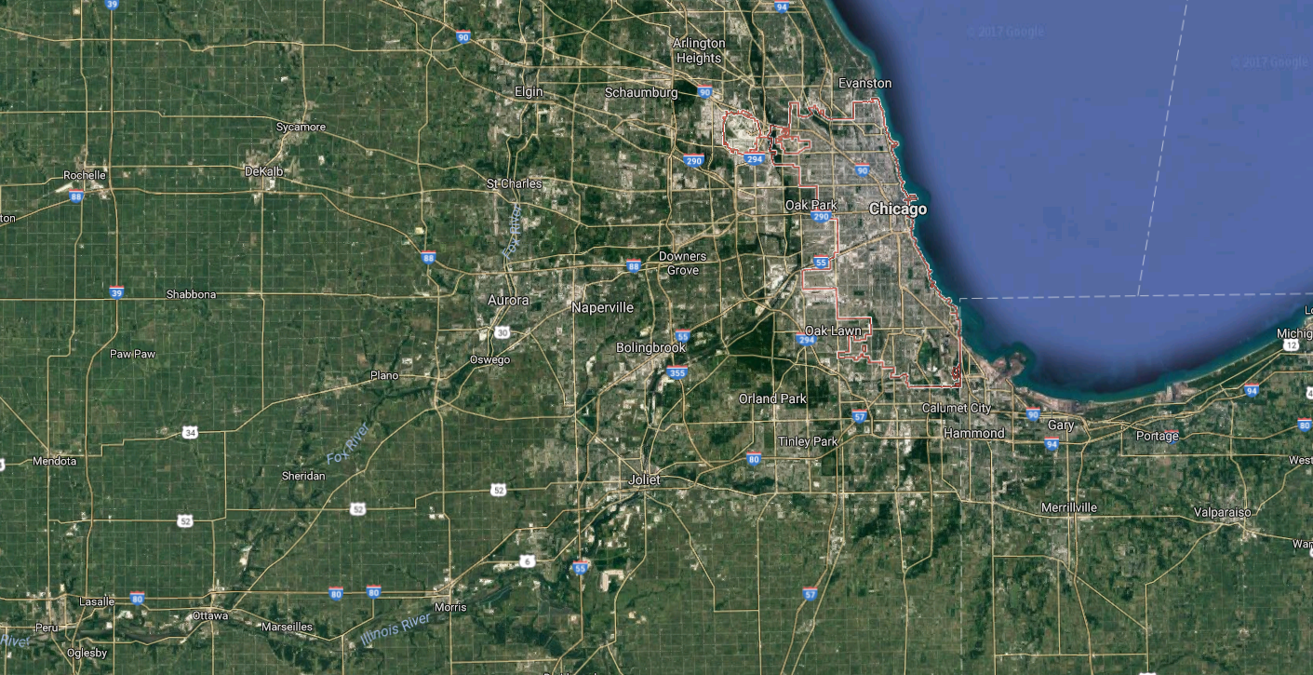
Chicago Sanitary and Ship Canal 1892: a creative solution

Slide 6
Southwark and Vauxhall Water Company
In 1850, the microbiologist Arthur Hassall wrote of the River Thames water they were using,"...a portion of the inhabitants of the metropolis are made to consume, in some form or another, a portion of their own excrement, and moreover, to pay for the privilege."
Next Cartoon presents John Edwards, owner of the Southwark Water Company, posing as Neptune ("Sovereign of the Scented Streams"). He is seen crowned with a chamber-pot, seated on a stool on top of a cesspool which doubles as the water-intake for the Southwark Water Company customers in south London.
Notes:
http://www.ph.ucla.edu/epi/snow/southwarkwatercompany.html (comments)

Slide 7
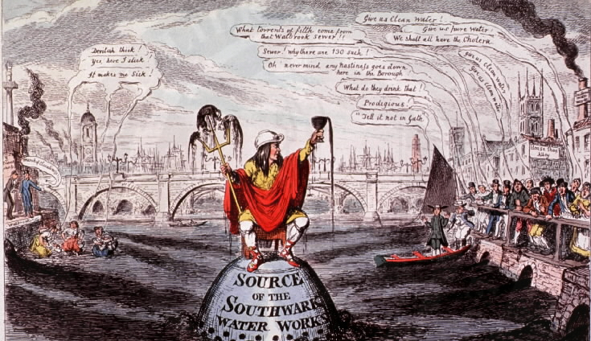
Southwark and Vauxhall Water Company
Courtesy of the National Library of Medicine
Notes:
http://wwwihm.nlm.nih.gov/ihm/images/A/24/183.jpg
Direct reuse without treatment

Slide 8
Drinking Water Treatment and Germ Theory
1829: First sand filter used to treat some of London's drinking water
1850: John Snow established the link between drinking water (from a contaminated well) and Cholera
1872: Poughkeepsie, NY installs first filter in US
1885: Sand filters are shown to remove bacteria
1892: Cholera outbreak in Hamburg, Germany

Slide 9
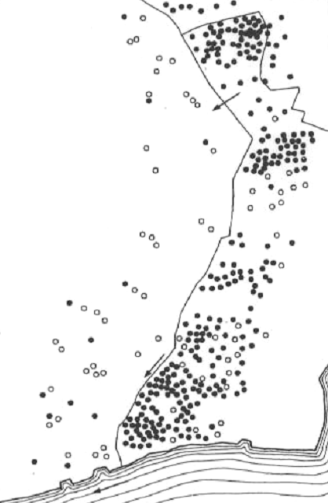
1892 Cholera outbreak in Hamburg Germany
Altona's water intake and filter beds
Hamburg
Altona
Hamburg's sewer outfalls
Hamburg's water intake
Elbe River
Large outbreak of Cholera in Hamburg
17,000 cases; 8,600 deaths
Very few cases in neighborhoods served by Altona's filtered water supply
Hamburg's sewers were upstream from Altona's intake!

Slide 10
Altona vs. Hamburg: Cholera Cases
Cholera cases
Cases in Altona acquired in Hamburg
Received water from Altona
Conclusions
Altona
Cholera was waterborne
Hamburg
Slow sand filtration may have protected Altona

Slide 11
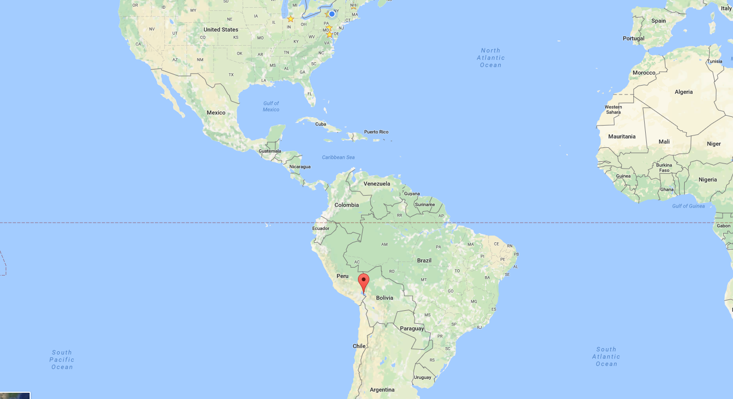
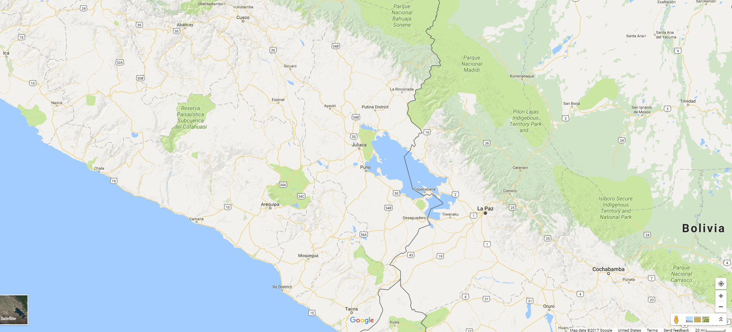
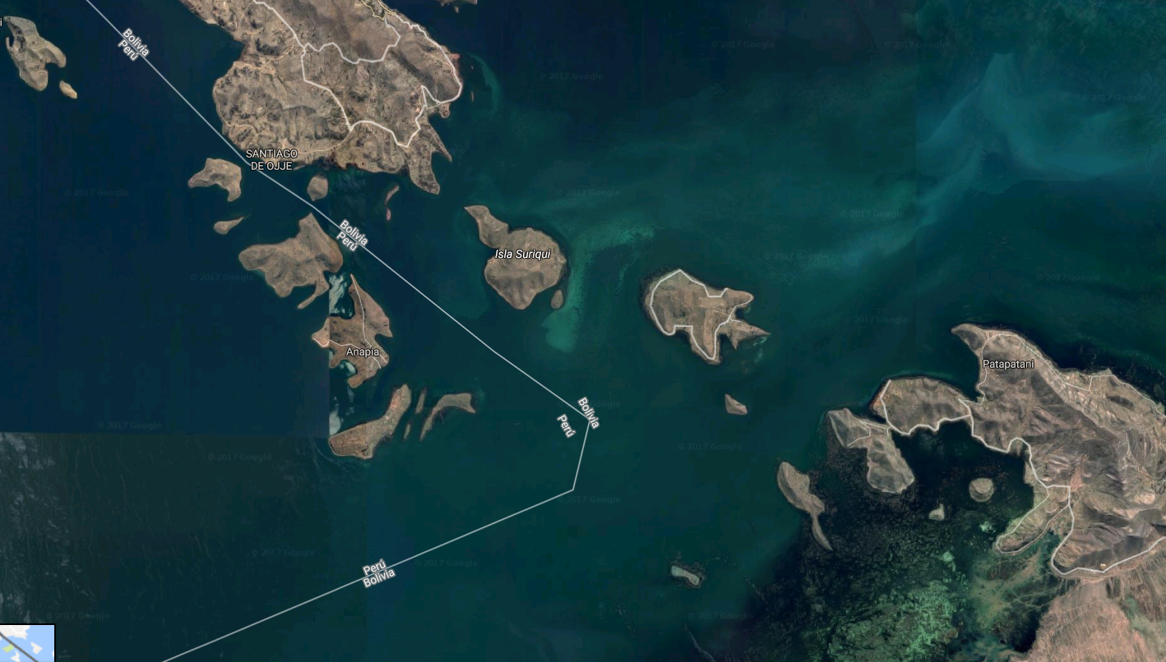
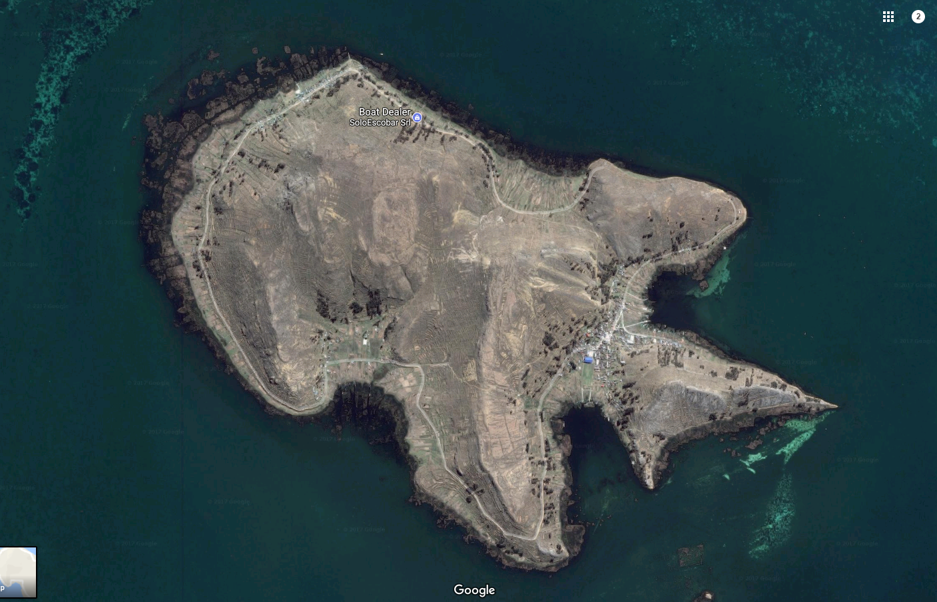
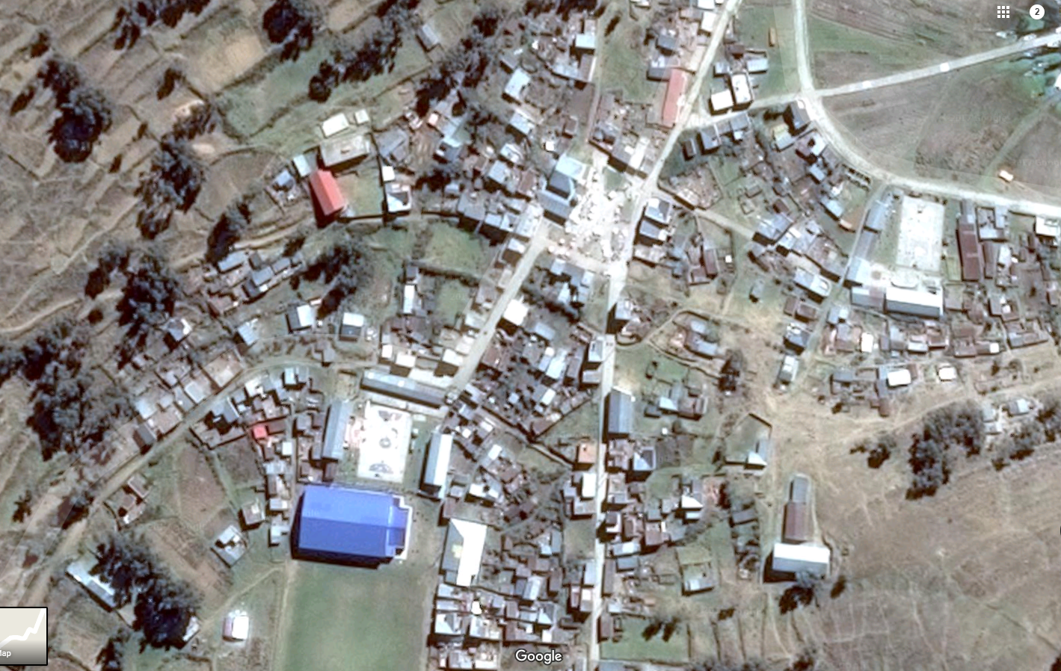
Lake Titicaca in the Andes Mountains
Notes:
We’d like to know what the status of the sewer system is on the island
If people are currently using latrines and then switch to toilets when they have more water, then we could have an unintended side effect of more untreated wastewater going into the lake. And the lake is their best source of water.

Slide 12
Fecal-Oral Pathways: a stochastic process
Hygiene
Water treatment
Sanitation
Pathogen source
Sanitation method
Environment
Transport
washing
Drinking water
Human excreta
Dry sanitation involving reuse
Hands
Surface water
Waterborne sewage
Water
Ground water
Oral
Non recycling latrines
Crops
Animal excreta
Food
Land application
Flies
Soil
Will you see an immediate improvement in public health with the installation of a water treatment plant?
Notes:
What technology that is commonly found in homes plays an important role in breaking the Fecal-Oral pathway? SINKS!

Slide 13
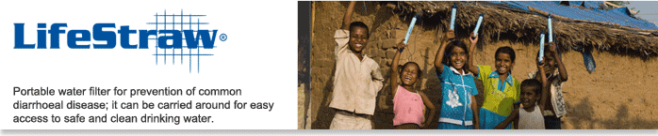
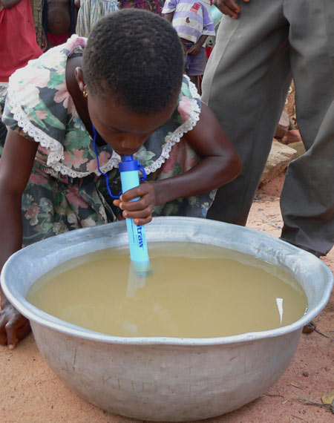
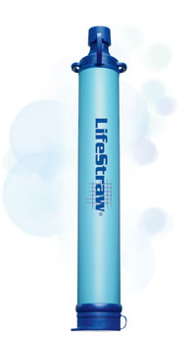
Notes:
What are two fecal oral pathways?
How will cap be removed?
Where does the mouth go?
Wet hand contaminated with dirty water removes cap
Hands carry feces if handwashing is not easy.

Slide 14
Waterborne Threats to Human Health
Infectious diseases
caused by viruses, bacteria, protozoa (pathogens)
https://confluence.cornell.edu/display/cee4540/Bad+Bugs
Noninfectious diseases
_____: caused by short term exposure to harmful chemicals
_______: caused by long term exposure to harmful chemicals
low levels of exposure to certain chemicals over a long period of time may cause cancer, liver and kidney damage, or central nervous system damage
acute
chronic

Slide 15

Propose a Drinking Water Standard
You have been granted the authority to regulate drinking water quality. Create a standard for the concentrations of disease-causing organisms in drinking water.
In the absence of technological/economic constraints,
Which pathogens would you regulate?
What concentration would you choose?
Given technological and economic constraints how might you change your regulation?
Setting the standards

Slide 16
Optimal Pathogen Exposure
Should we be exposed to small doses of pathogens so we build up our resistance?
How could we build pathogen exposure into our daily lives?
Potential application
Common cold (continues to mutate)
Norwalk virus (Immunity, however, is not permanent and re-infection can occur after 2 years)
HIV (no immunity)
The case of Typhoid
Early exposure to germs has lasting benefits. Nature, March 2012
Immune systems of healthy adults 'remember' germs to which they’ve never been exposed, Stanford study Feb 2013
Notes:
Do you ask friends to cough on you?

Slide 17
Safe Drinking Water Act (1974)
Specific standards for drinking water
primary (__________)
secondary (__________ upper limits for non-health related parameters)
Applicable to all water supplies serving more than 25 people or having 15 or more service connections
Enforced by U.S. Environmental Protection Agency
mandatory
suggested

Slide 18
Primary Standards: (Health) 6 Broad Categories
Microorganisms
Disinfectants
Disinfection Byproducts
Inorganic Chemicals
Organic Chemicals
Radionuclides
Where is “dirt”?

Slide 19
Primary Standards: (Health) Inorganic chemicals (units of mg/L)
Contaminant U.S. EPA
Antimony 0.006
Arsenic 0.01
Asbestos (fiber >10 micrometers) 7 MFL
Barium 2
Beryllium 0.004
Cadmium 0.005
Chromium (total) 0.1
Copper Action Level=1.3; TT⁸
Cyanide (as free cyanide) 0.2
Fluoride 4.0
Lead Action Level=0.015; TT⁸
Inorganic Mercury 0.002
Nitrate (measured as Nitrogen) 10
Nitrite (measured as Nitrogen) 1
Selenium 0.05
Thallium 0.002
Notes:
http://water.epa.gov/drink/contaminants/index.cfm
Also see WHO at http://www.who.int/water_sanitation_health/dwq/2edvol1c.pdf?ua=1

Slide 20
Primary Standards: (Health) A Few Organic Chemicals (units of mg/L) see the complete list!
Contaminant MCLG MCL
Acrylamide zero TT⁷
Alachlor zero 0.002
Atrazine 0.003 0.003
Benzene zero 0.005
1-1-Dichloroethylene 0.007 0.007
Dioxin (2,3,7,8-TCDD) zero 0.00000003
Epichlorohydrin zero TT⁷
Ethylbenzene 0.7 0.7
Ethelyne dibromide zero 0.00005
Lindane 0.0002 0.0002
Polychlorinated biphenyls (PCBs) zero 0.0005
Tetrachloroethylene zero 0.005
Toluene 1 1
Total Trihalomethanes (TTHMs) none⁵ 0.10
Trichloroethylene zero 0.005
Vinyl chloride zero 0.002
Xylenes (total) 10 10

Slide 21
Primary Standards : (Health) Related to Microorganisms
Contaminant MCLG MCL
Cryptosporidium zero TT³
Giardia lamblia zero TT³
Legionella zero TT³
Viruses (enteric) zero TT³
Heterotrophic plate count N/A TT³
Total Coliforms zero 5.0%⁴
Turbidity N/A TT³
Cause disease
Indicators
Pathogens are a subset of particles

Slide 22
Microbial Contaminants
For microbial contaminants that may present public health risk, the MCLG is set at zero because ingesting one protozoa, virus, or bacterium may cause adverse health effects.
The MCL is set as close to the MCLG as feasible, (the level that may be achieved with the use of the best available technology, treatment techniques, and other means which EPA finds are available), taking cost into consideration.

Slide 23
Treatment Technique (TT)
When there isn’t an economical and technically feasible method to measure a contaminant, a Treatment Technique is set rather than an MCL.
A treatment technique is an enforceable procedure or level of technological performance which public water systems must follow to ensure control of a contaminant.
Surface Water Treatment Rule (disinfection and filtration)
Lead and Copper Rule (optimized corrosion control).

Slide 24
Turbidity
A measure of the scattering of light by particles in a suspension
A turbid water sample appears cloudy or “dirty”
High turbidity is the result of lots of light scattering caused by the particles in suspension
Measured in NTU (Nephelometric Turbidity Units)
cloud

Slide 25
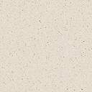
Turbidity Measurements
lens
90° detector
lamp
180° detector
sample cell
170° detector
LED
Turbidity Sensors (approximate turbidity measurement)
sample cell

Slide 26
Secondary Standards: Aesthetics
Contaminant U.S. EPA, 1993 WHO, 1984
Aluminum 0.5-0.2 mg/L 0.2 mg/L
Chloride 250 mg/L 250 mg/L
Color 15 color units 15 color units
Copper 1.0 mg/L 1.0 mg/L
Corrosivity Noncorrosive
Fluoride 2.0 mg/L
Foaming agents 0.5 mg/L
Iron 0.3 mg/L 0.3 mg/L
Manganese 0.05 mg/L 0.1 mg/L
Odor (Threshold Odor Number) 3 TON
pH 6.5-8.5 6.5-8.5
Silver 0.1 mg/L
Sulfate 250 mg/L 400 mg/L
Total dissolved solids 500 mg/L 1000 mg/L
Zinc 5.0 mg/L 5.0 mg/L
Notes:
http://water.epa.gov/drink/contaminants/index.cfm#Secondary

Slide 27
What would you measure before drinking the water?
Surface water (big concern is pathogens)
Turbidity (pathogens are particles)
Chlorine residual
Ground water (big concern is still pathogens)
Turbidity
Chlorine residual
Arsenic and fluoride (depending on location)
Organic chemicals (agricultural and industrial)

Slide 28
Effect of Chlorination on Inactivating Selected Bacteria
Bacteria | Cl₂ (mg/l) | Time (min) | Ct Factor (mg-min/l) | Reduction(%) | Ct for pC* of1 | Reference
Campylobacter jejuni | 0.1 | 5 | 0.5 | 99.99 | 0.125 | Blaser et al, 1986
Escherichia coli | 0.2 | 3 | 0.6 | 99.99 | 0.15 | Ram and Malley, 1984
Legionella pneumophila | 0.25 | 60-90 | 18.75 | 99 | 9.4 | Kuchta et al, 1985
Mycobacterium chelonei | 0.7 | 60 | 42 | 99.95 | 13 | Carson et al, 1978
Mycobacterium fortuitum | 1.0 | 30 | 30 | 99.4 | 13.5 | Pelletier and DuMoulin, 1987
Mycobacterium intracellulare | 0.15 | 60 | 9 | 70 | 17.2 | Pelletier and DuMoulin, 1987
Pasteurella tularensis | 0.5-1.0 | 5 | 3.75 | 99.6-100 | 1.6 | Baumann and Ludwig, 1962
Salmonella typhi | 0.5 | 6 | 3 | 99 | 1.5 | Korol et al, 1995
Shigella dysenteriae | 0.05 | 10 | 0.5 | 99.6-100 | 0.2 | Baumann and Ludwig, 1962
Staphylococcus aureus | 0.8 | 0.5 | 0.4 | 100 | -- | Bolton et al, 1988
Vibrio cholerae(smooth strain) | 1.0 | < 1 | < 1 | 100 | -- | Rice et al, 1993
Vibrio cholerae (rugose strain) | 2.0 | 30 | 60 | 99.999 | 12 | Rice et al, 1993
Yersinia enterocolitica | 1.0 | 30 | 30 | 92 | 27 | Paz et al, 1993
Notes:
http://www.cdc.gov/safewater/about_pages/chlorinationtable.htm
I calculated the Ct for a pC* of 1. This assumes that chick’s law applies and that die off is proportional to the concentration.

Slide 29
Effect of Chlorination on Inactivating Selected Viruses
Viruses | Cl₂ (mg/l) | Time (min) | Ct factor (mg-min/l) | Reduction (%) | Ct for pC* of1 | Reference
Adenovirus | 0.2 | 40-50 sec | 0.15 | 99.8 | 0.06 | Clarke et al, 1956
Coxsackie | 0.16-0.18 | 3.8 | 0.06 | 99.6 | 0.025 | Clarke and Kabler, 1954
Hepatitis A | 0.42 | 1 | 0.42 | 99.99 | 0.105 | Grabow et al, 1983
Norwalk | 0.5-1.0 | 30 | 22.5 | -- | -- | Keswick et al, 1985
Parvovirus | 0.2 | 3.2 | 0.64 | 99 | 0.32 | Churn et al, 1984
Poliovirus | 0.5-1.0 | 30 | 22.5 | 100 | -- | Keswick et al, 1985
Rotavirus | 0.5-1.0 | 30 | 22.5 | 100 | -- | Keswick et al, 1985
Notes:
http://www.cdc.gov/safewater/about_pages/chlorinationtable.htm
I calculated the Ct for a pC* of 1. This assumes that chick’s law applies and that die off is proportional to the concentration.

Slide 30
Effect of Chlorination on Inactivating Selected Protozoa
Protozoa | Cl₂ (mg/l) | Time (min) | Ct Factor (mg-min/l) | Reduction (%) | Ct for pC* of 1 | Reference
Cryptosporidium parvum | 80 | 90 | 7200* | 90 | 7200 | Korich et al, 1990
Entamoeba histolytica | 1.0 | 50 | 50 | 100 | -- | Snow, 1956
Giardia lamblia | -- | -- | 68-389 | 99.9 | 30 | AWWA, 1999
Naegleria fowleri | 0.5-1.0 | 60 | 45 | 99.99 | 11 | de Jonckheere and van de Voorde, 1976
How many pathogens does it take to make you sick?
https://confluence.cornell.edu/display/cee4540/Bad+Bugs
Notes:
http://www.cdc.gov/safewater/about_pages/chlorinationtable.htm
I calculated the Ct for a pC* of 1. This assumes that chick’s law applies and that die off is proportional to the concentration.

Slide 31
Which pathogens are a big concern even with Chlorine?
Pathogens with a small infective dose and high resistance to chlorine
Cryptosporidium parvum
Giardia lamblia

Slide 32
Summary
The causes of many waterborne disease have been identified
Standards for microbiological and chemical contaminants have been set by US EPA and the World Health Organization
Waterborne disease continues to be a significant public health concern especially for the poorest 2 billion
Toilets (pollute the environment) and Sinks (clean our hands)

